Slide 1
Lesson 5: Review of Assessment and Introduction to Command Based Code
Fe Maidens Programming 2017-2018

Slide 2
Prompt 1:
Write the import statements for the RobotDrive and Joystick classes.
Write a method called drive() that will allow somebody to control the robot in tank drive using a controller.
Given:
-The RobotDrive has been defined as TankDrive.
-The robot will be controlled by a Joystick defined as atkJoy.
-The left side of the robot will be controlled by axis 1.
-The right side of the robot will be controlled by axis 5.

Slide 3
Ideal Answer
//imports
import edu.wpi.first.wpilibj.Joystick; import edu.wpi.first.wpilibj.RobotDrive;
//creation of method
public void drive(){
//use of API to get input from axis
double left = atkJoy.getRawAxis(1);
double right = atkJoy.getRawAxis(5);
//use of tankDrive
TankDrive.tankDrive(left, right);
}

Slide 4
Prompt 2:
Write the extend() and retract() method that will make a piston extend and retract respectively.
Given:
-The class has has already been made.
-The piston is controlled by a double solenoid.
-The double solenoid is defined as sol.

Slide 5
Ideal Answer
//creation of methods
public void extend(){
//use of set method
//use of DoubleSolenoid.Value.kForward
sol.set(DoubleSolenoid.Value.kForward);
}
public void retract(){
sol.set(DoubleSolenoid.Value.kReverse);
}

Slide 6
Prompt 3:
Write a method called setMotor() that takes a parameter speed that allows you to set a motor’s speed to whatever you want. Then, call the method to set the motor to half speed forward.
Given:
-The motor is controlled by a Talon called leftMotor.
-You don’t need to reference any object when calling the setMotor() method.

Slide 7
Ideal Answer
//creation of method and parameter
public void setMotor(double speed){
//use of set with parameter
leftMotor.set(speed);
}
//calling the method
setMotor();

Slide 8

Github Accounts Accounr

Slide 9
Command-Based Programming (INTRO)
Command based programming is a design pattern to help you organize our robot programs.
Activities happen over time, for example a sequence of steps to shoot a Frisbee or raise an elevator and place a tube on a goal.
These activities occur concurrently, that is it might be desirable for an elevator, wrist and gripper to all be moving into a pickup position at the same time to increase robot performance.
Notes:
https://wpilib.screenstepslive.com/s/4485/m/13809/l/599732-what-is-command-based-programming

Slide 10
Command-Based Programming (INTRO)
Three types of classes: commands, subsystems, and command groups
Subsystems usually refer to the different parts of the robot rather than entire mechanisms
Examples: driveTrain, climber, cannon, gear chute
Commands define the capabilities of the parts of the robot defined above. It helps you break the tasks into smaller chunks and operate from there. Commands run either from a scheduler or from buttons pressed on the joystick using a method called bindButtons().
Examples: DriveStraight, Climb, Shoot, ShiftChute
Command groups are exactly what they sound like. They can run things in order using addSequential and run commands at the same time using addParallel. They combine simpler commands to make a more complex one
Notes:
https://wpilib.screenstepslive.com/s/4485/m/13809/l/599732-what-is-command-based-programming

Slide 11
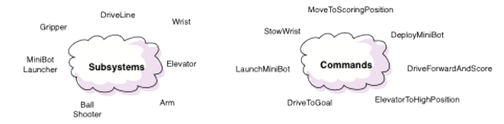
Commands and Subsystems

Slide 12
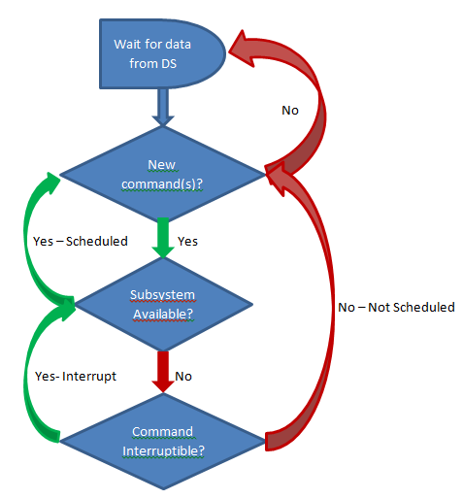
Scheduling Commands
There are three main ways commands are scheduled:
Manually, by calling the start() method on the command (used for autonomous)
Automatically by the scheduler based on button/trigger actions specified in the code (typically defined in the OI class but checked by the Scheduler).
Automatically when a previous command completes (default commands and command groups).

Slide 13
Scheduling Commands
Each time the driver station gets new data, the periodic method of your robot program is called. It runs a Scheduler that checks the trigger conditions to see if any commands need to be scheduled or canceled.
When a command is scheduled, the Scheduler checks to make sure that no other commands are using the same subsystems that the new command requires.
If one or more of the subsystems is currently in use, and the current command is interruptible, it will be interrupted and the new command will be scheduled.
If the current command is not interruptible, the new command will fail to be scheduled.
The method isInterrupted() is called when another command which requires one or more of the same subsystems is scheduled to run
Notes:
If the current command is interruptible, it will be interrupted and the new command will be scheduled. If the current command is not interruptible, the new command will fail to be scheduled.

Slide 14
Running Commands
(and Structure)
After checking for new commands, the scheduler proceeds through the list of active commands and calls the execute() and isFinished() methods on each command.
Each command simply has some code to execute (execute method) to move it further along towards its goal and a method (isFinished) that determines if the command has reached the goal.
The execute() and isFinished() methods are just called repeatedly.

Slide 15
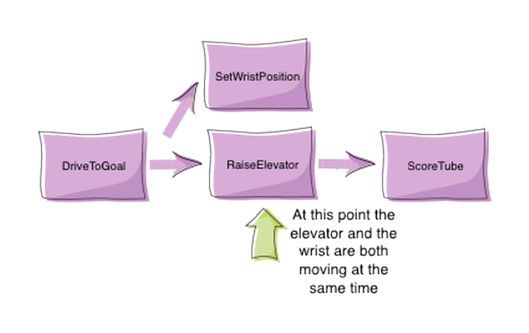
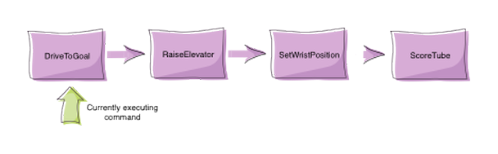
Command groups
Periodically
Concurrently
addSequential()
addParallel()

